Slide 1
Is world food security guaranteed? Turmoil in world grain markets amid uncertain future
XIII Foro de Expectativas del Sector Agroalimentario y Pesquero, 10 y 11 de abril en el hotel Hilton Reforma
Abdolreza Abbassian
Food and Agricultural Organization of the United Nations, FAO
Senior Economist & Secretary of the Agricultural Market Information System (AMIS) of G20
Abdolreza.Abbassian@fao.org

Slide 2
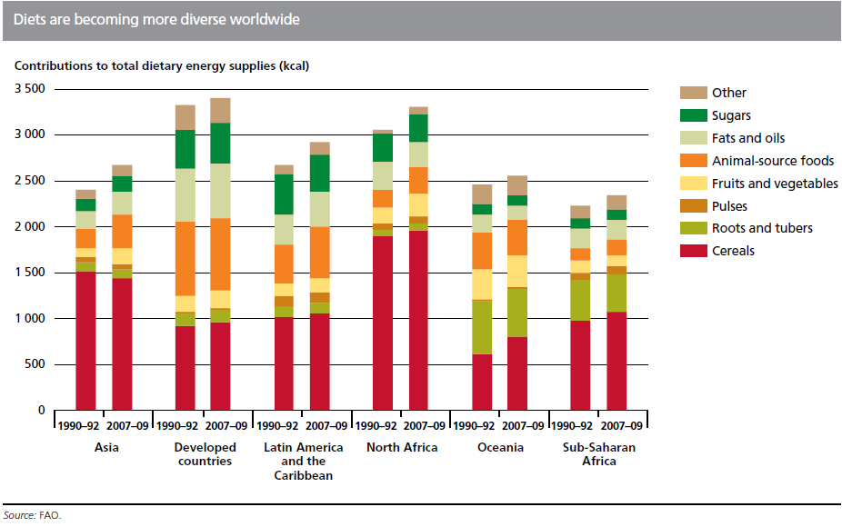

Slide 3
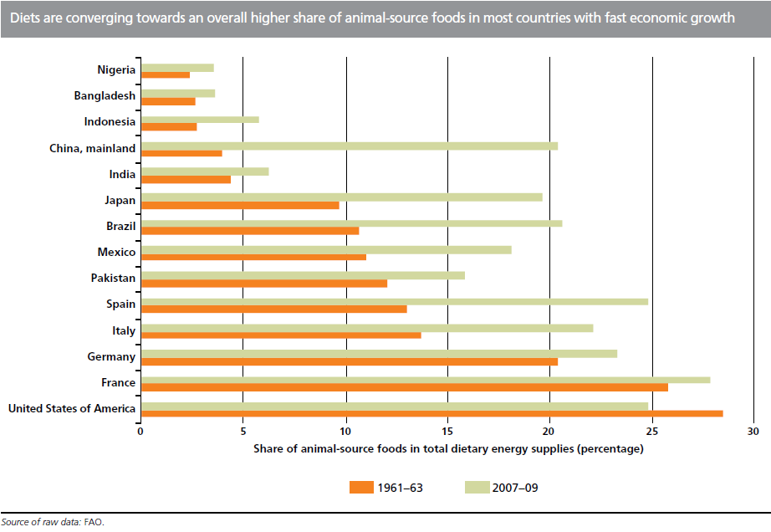

Slide 4
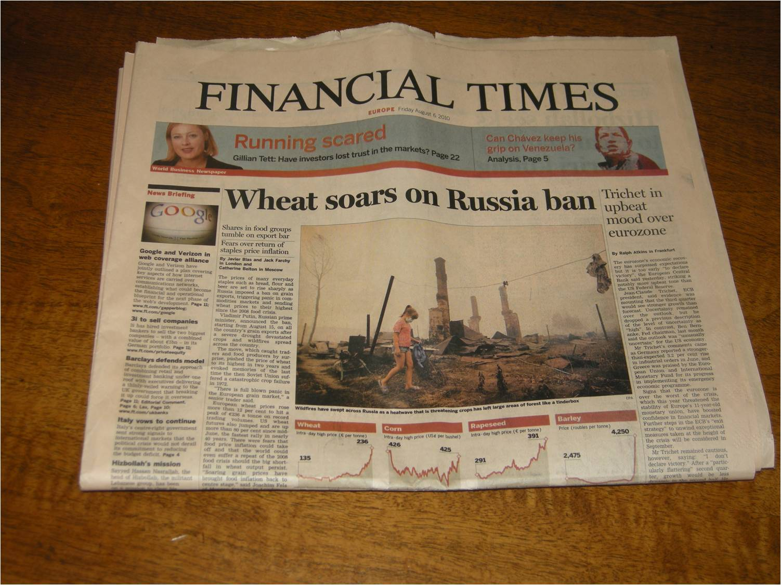

Slide 6
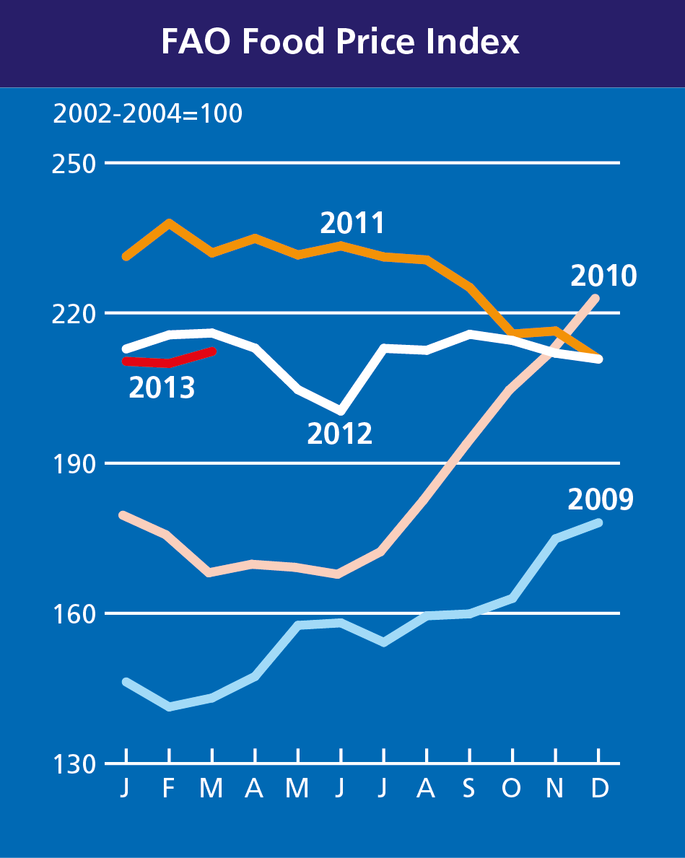
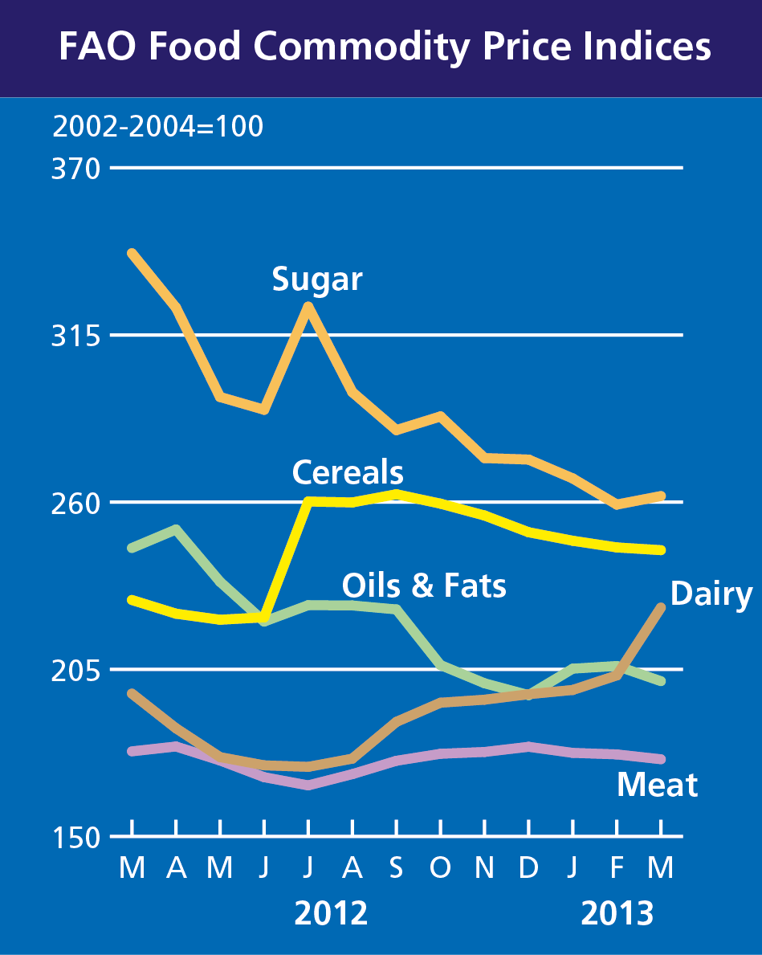

Slide 7
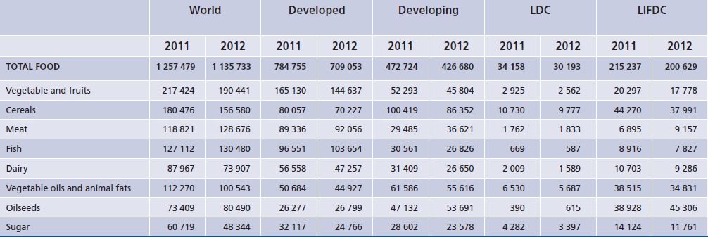
Food Import bills (USD billion)

Slide 8
Many factors influence grain prices
Russian Drought
and Export Ban
Drought in the US
Political Tensions
Unfavourable Macroeconomic Conditions
Euro Crisis
Uncertain growing conditions in US & China but also CIS production recovery
2010
2011
2012
2013

Slide 9
& for rice, trade policy matters even more!
Notes:
International rice prices have fluctuated in recent months, under the influence not only of the market fundamentals but especially of changes in policies by two of the major market players, namely India and Thailand.
While may drivers of prices are indicated in the graph, I want to highlight in particular the effect already in June 2011 of the election of a new government in Thailand, which based much of its campaign on the promise to raise rice producer prices. This had the effect to boost export prices already in June, well before the pledging programme that guaranteed price increases of at least 25 percent, was implemented in October 2011.
Much of the boosting effect of the policy on international prices waned when India, which had banned regular rice exports since 2008, lifted the ban and resumed exports.
In the past month, prices have strengthened again. One of the factors behind the trend reversal has been the imminent raising of duties by Nigeria, which has fostered a rush to import rice ahead of its coming into force in July.

Slide 10
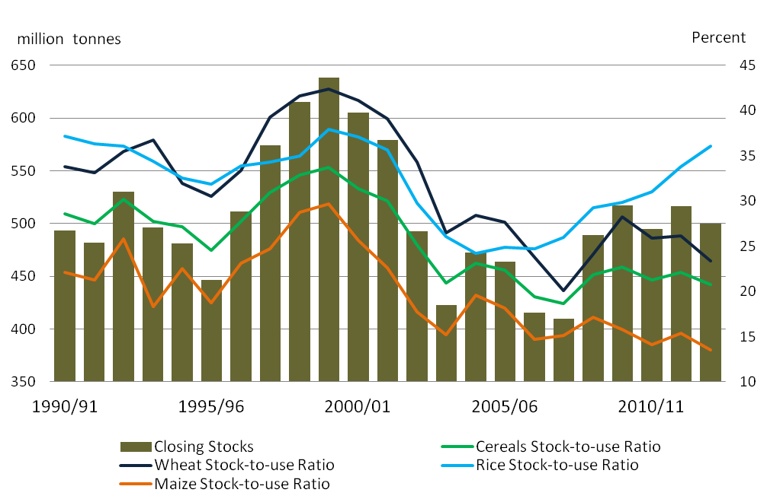
Depleting Stock levels & Tightening Supplies

Slide 11
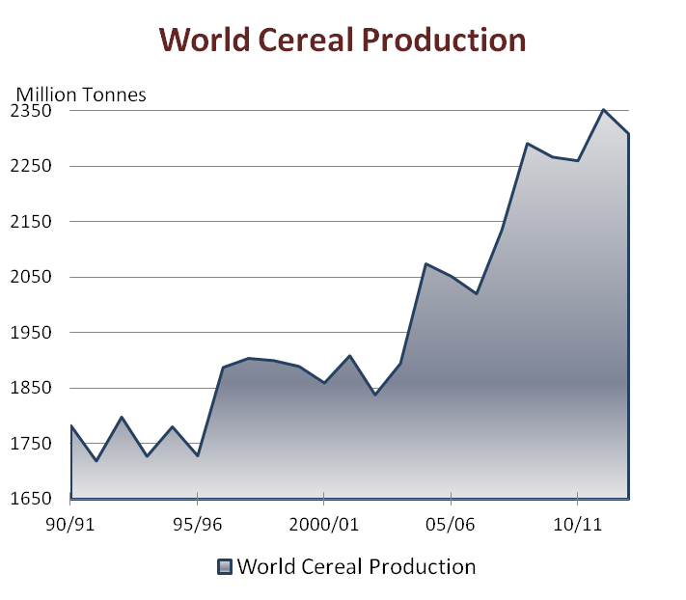
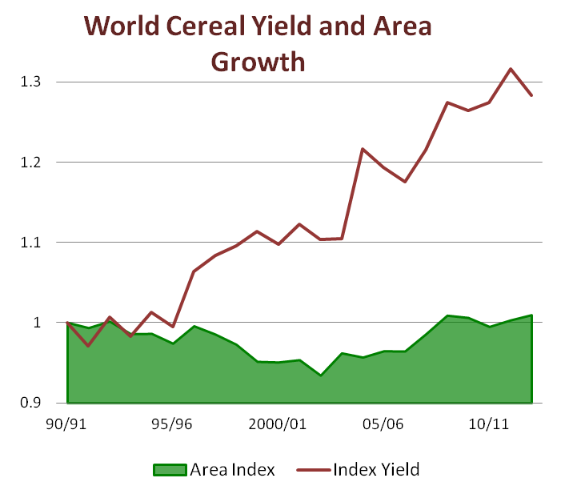

Slide 12
More turmoil than in past, why?
Much lower cereal stocks
More production from less stable (in terms of yields) regions (Russia, Ukraine, etc.)
Growing links with outside markets (energy, financial, etc.)
Increased dependence on imports and hence world trade
Few exporters accounting for most of the export supply
Restrictive trade measures (export taxes)
Climate change (stronger weather swings)
What to do?
Reduce price volatility in international markets; mitigate their impacts
How?
Enhance safety nets for the most vulnerable
Invest in agriculture
Notes:
12

Slide 13
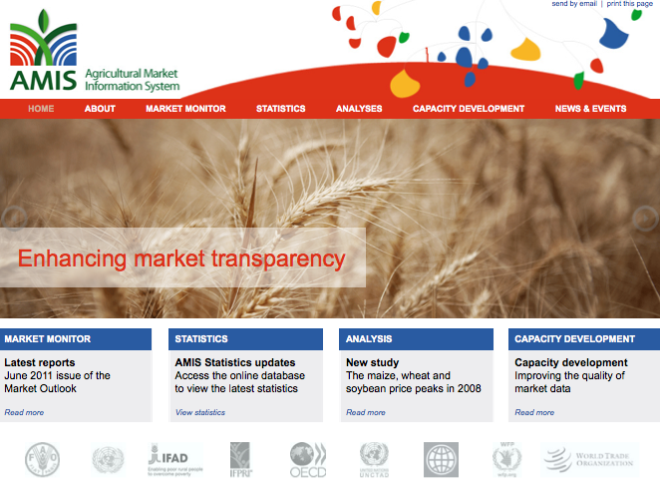
Improve market information and transparency
www.amis-outlook.org

Slide 14
AMIS Participants and Coverage G20 countries, Spain and seven non-G20 countries selected due to their significant share in global production and trade for the four commodities covered by AMIS (Wheat, Rice, Maize and Soybean).
AMIS Secretariat is formed by FAO, IFAD, IFPRI, IGC, WFP, OECD, World Bank, WTO, UNCTAD, and the UN-HLTF. It is responsible for producing market outlooks, analysis, and supports all functions of the Forum and the IG. It is housed in FAO.
The Information Group consists of technical representatives (Focal Points) from participant countries. It provides national market and policy information to the Secretariat. It meets twice a year.
The Rapid Response forum composed by Senior Officials from participant countries. It aim to foster early discussion among decision-level officials to encourage coordination of policies. It meets as needed, but in principle not less than once a year.
AMIS Chair Presides over meetings of the Forum and the Information Group. Elected for one year. 1st chair was France, now is the United States and next is Australia.

Slide 15
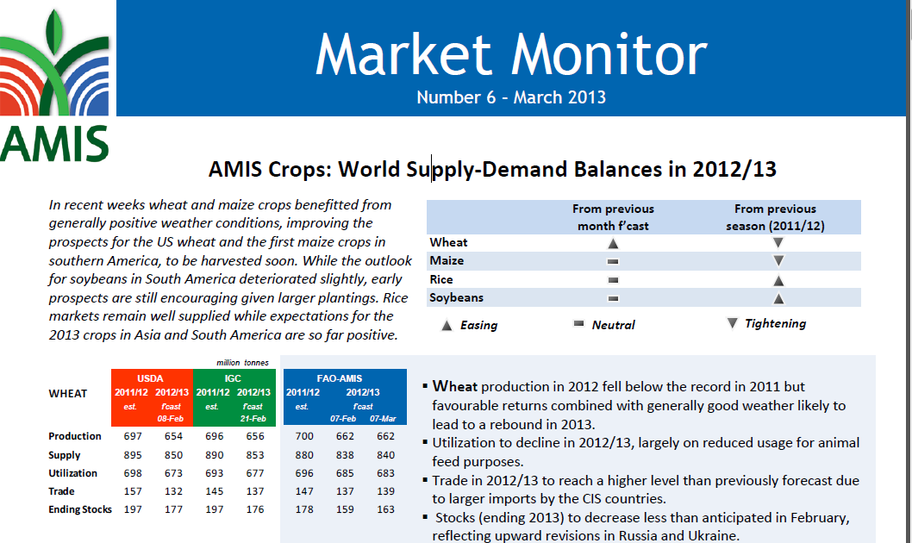
Monthly Forecasts and Analysis

Slide 16
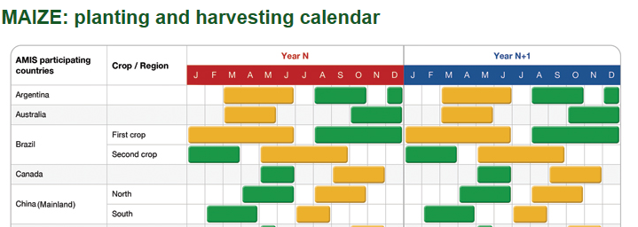
Mexico is among the leading contributors to AMIS

Slide 17
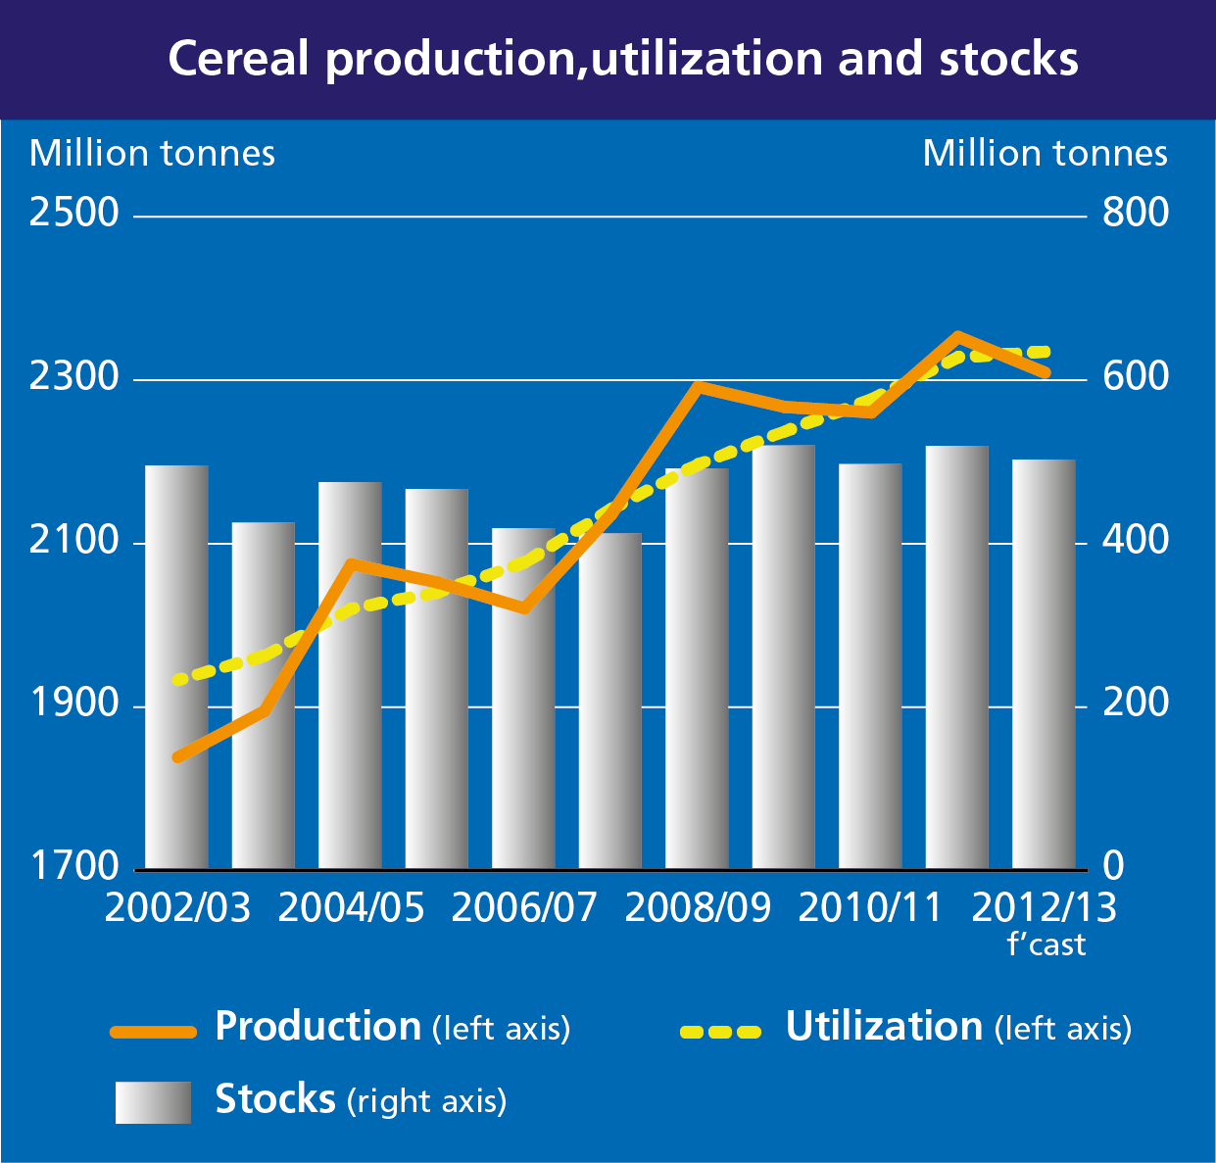
Cereal Market at a glance: Where are we today?

Slide 18
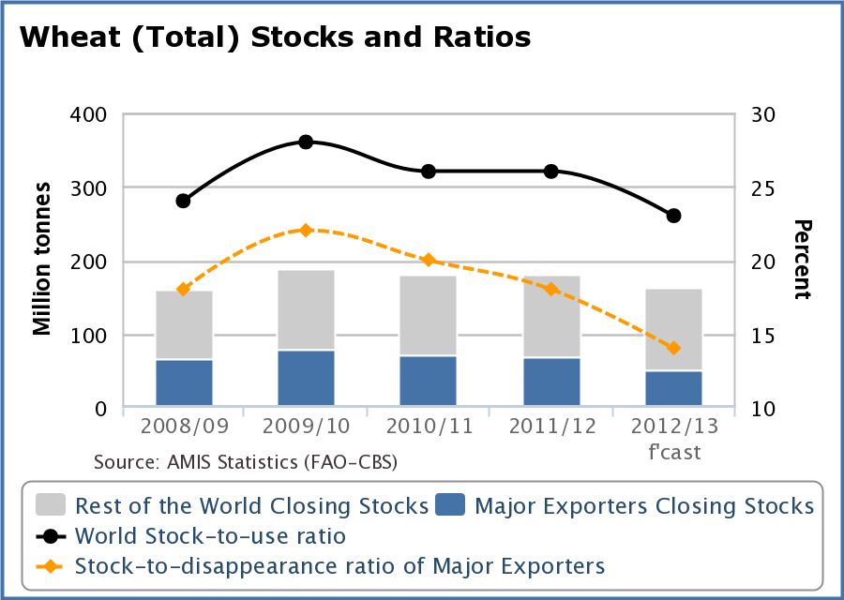
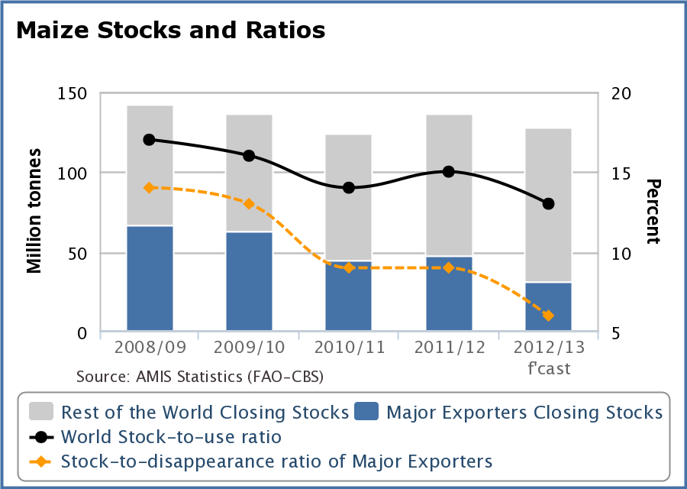

Slide 19
Prices have fallen recently….

Slide 21
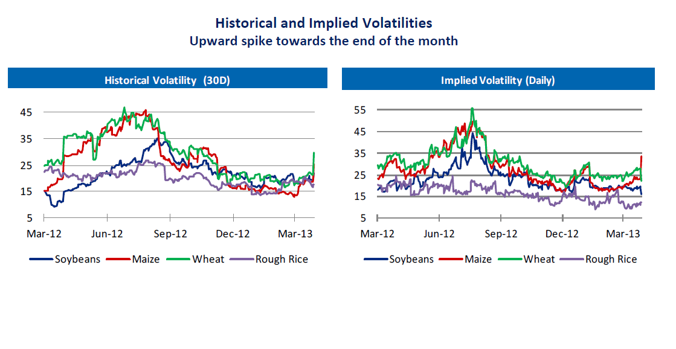

Slide 22
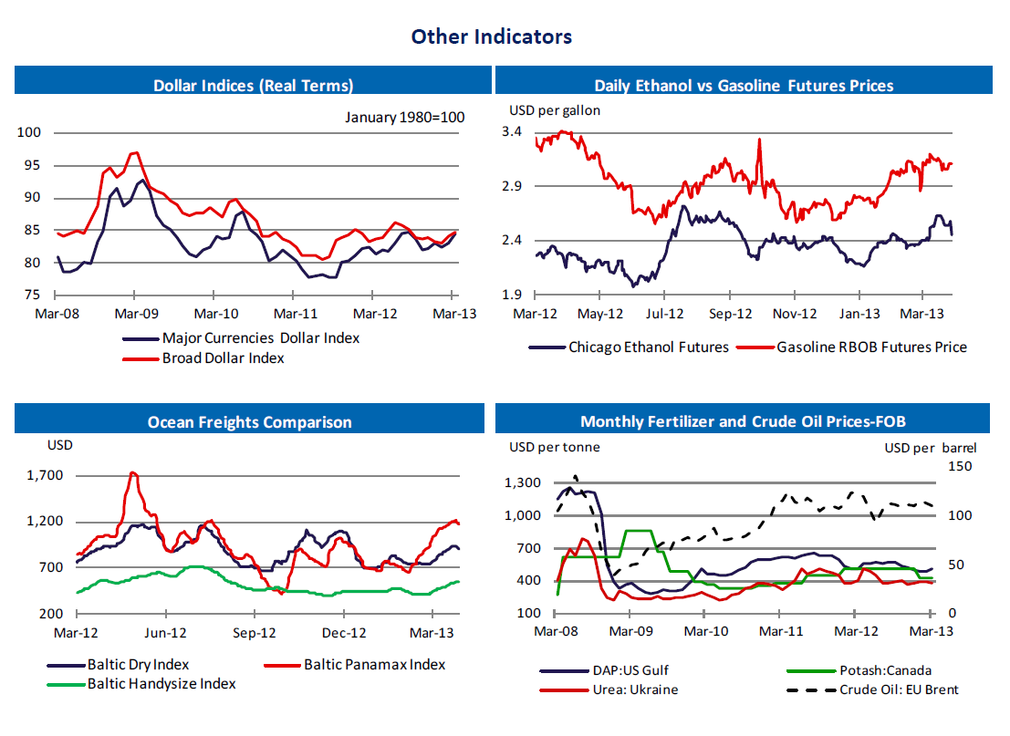

Slide 23
Early prospects for wheat in 2013/14
FAO projects production to increase by 4.4% to 690 mt
Stocks not recovering?

Slide 24
Early prospects for coarse grains in 2013/14
Too early to forecast production but early indications suggest enough expansion to help stocks recover slightly

